Slide 1
Object Oriented Programming Lecture - 6
Prof. Dnyaneshwar Kanade

Slide 2
Private Constructors
Private constructors allow us to restrict the instantiation of a class.
They prevent the creation of class instances in any place other than the class itself.
Public and private constructors, used together, allow control over how we wish to instantiate our classes – this is known as constructor delegation.

Slide 3
Usage of Private Constructors
There are several patterns and benefits to restricting explicit class instantiation:
The singleton pattern
Delegating constructors
Uninstantiable classes
The builder pattern

Slide 4
What is a Singleton class?
As the name implies, a class is said to be singleton if it limits the number of objects of that class to one.
We can’t have more than a single object for such classes.
Singleton classes are employed extensively in concepts like Networking and Database Connectivity.
The constructor of singleton class would be private so there must be another way to get the instance of that class.
This problem is resolved using a class member instance and a factory method to return the class member.

Slide 5
What is a Singleton class?
We changed value of a.x, value of b.x also got updated because both ‘a’ and ‘b’ refer to same object, i.e., they are objects of a singleton class.
Example

Slide 6
Copy Constructor
A copy constructor in a Java class is a constructor that creates an object using another object of the same Java class.
That's helpful when we want to copy a complex object that has several fields, or when we want to make a deep copy of an existing object.
Like C++, Java also supports copy constructor. But, unlike C++, Java doesn’t create a default copy constructor if you don’t write your own.

Slide 7
Why copy constructor is required?
Sometimes, we face a problem where we required to create an exact copy of an existing object of the class.
There is also a condition, if we have made any changes in the copy it should not reflect in the original one and vice-versa.
For such cases, Java provides the concept of a copy constructor.
In Java, a copy constructor is a special type of constructor that creates an object using another object of the same Java class.
It returns a duplicate copy of an existing object of the class.

Slide 8
Use of Copy Constructor
We can use the copy constructor if we want to:
Create a copy of an object that has multiple fields.
Generate a deep copy of the heavy objects.
Avoid the use of the Object.clone() method.

Slide 9
Advantages of Copy Constructor
If a field declared as final, the copy constructor can change it.
There is no need for typecasting.
Its use is easier if an object has several fields.
Addition of field to the class is easy because of it.
We need to change only in the copy constructor.

Slide 10
How to Create a Copy Constructor
Example

Slide 11
Garbage Collection
Since objects are dynamically allocated by using the new operator, you might be wondering how such objects are destroyed and their memory released for later reallocation.
In some languages, such as traditional C++, dynamically allocated objects must be manually released by use of a delete operator.
Java does it automatically.
The technique that accomplishes this is called Garbage Collection.

Slide 12
How Garbage Collection Works
It works like this:
when no references to an object exist, that object is assumed to be no longer needed, and the memory occupied by the object can be reclaimed.
There is no need to explicitly destroy objects.
Garbage collection only occurs sporadically (if at all) during the execution of your program.
It will not occur simply because one or more objects exist that are no longer used.
Furthermore, different Java run-time implementations will take varying approaches to garbage collection, but for the most part, you should not have to think about it while writing your programs.

Slide 13
Garbage Collection
Since objects are dynamically allocated by using the new operator, you might be wondering how such objects are destroyed and their memory released for later reallocation.
In some languages, such as traditional C++, dynamically allocated objects must be manually released by use of a delete operator.
Java does it automatically.
The technique that accomplishes this is called Garbage Collection.

Slide 14
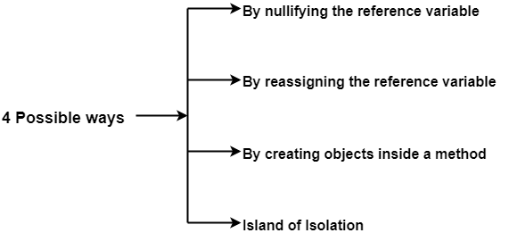
Ways to make an object eligible for garbage collection in Java-
There are 4 different ways in which an object can be made eligible for the purpose of garbage collection-

Slide 15
Ways to make an object eligible for garbage collection in Java-
By nullifying the reference variable-
In this method, programmer assigns null to the reference variables of all those objects which are no longer required.
This makes the useless objects automatically eligible for the purpose of garbage collection.

Slide 16
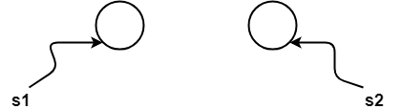


Ways to make an object eligible for garbage collection in Java-
1. By nullifying the reference variable- Example
1. Student s1 = new Student( );
2. Student s2 = new Student( );
3. .
4. .
5. .
6. .
7. s1 = null;
8. .
9. .
10. .
11. .
12. s2 = null;
13. .

Slide 17
Ways to make an object eligible for garbage collection in Java-
2. By reassigning the reference variable-
As the name suggests,
In this method, programmer reassigns the reference variables of all those objects which are no longer needed to some other objects.
This makes the useless objects automatically eligible for the purpose of garbage collection.

Slide 18
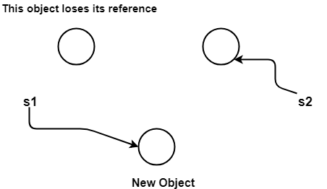
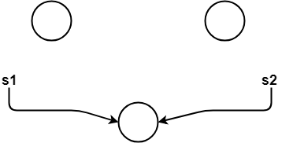
Ways to make an object eligible for garbage collection in Java-
1. By reassigning the reference variable-Example
1. Student s1 = new Student( );
2. Student s2 = new Student( );
3. .
4. .
5. .
6. .
7. s1 = new Student( );
8. .
9. .
10. .
11. .
12. s2 = s1;
13. .

Slide 19
Ways to make an object eligible for garbage collection in Java-
3. By creating objects inside a method-
As the name suggests,
In this method, programmer creates the objects inside the methods because after the method gets executed completely, objects present inside the method body automatically becomes eligible for the purpose of garbage collection.
The reason behind it is that the reference variables are the local variables of the method and after the method has executed completely, all the local variables are automatically destroyed.

Slide 20
Ways to make an object eligible for garbage collection in Java-
3. By creating objects inside a method- Example
1. class Test
2. {
3. public static void main(String[ ] args)
4. {
5. m1( );
6. }
7.
8. public static void m1( )
9. {
10. Student s1 = new Student( );
11. Student s2 = new Student( );
12. }
13.}

Slide 21
Ways to make an object eligible for garbage collection in Java-
4. Island of Isolation-
Island of Isolation describes the situation where there exists one or more objects in the program which are not accessible from anywhere in the application as they contain no external reference to them.
It is not possible to access such objects through any means as they have no external reference to them and thus they become eligible for garbage collection.
So, it appears as if the objects are stuck on some isolated island and they can not be accessed through any means. Hence, the name “Island of Isolation” is quite apt.

Slide 22
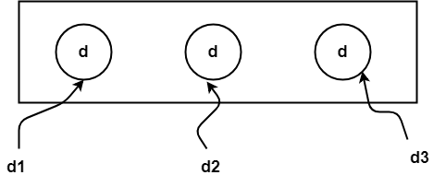
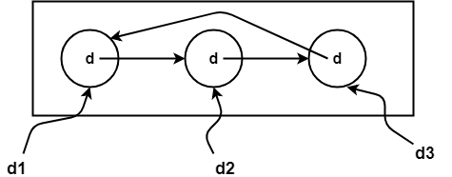
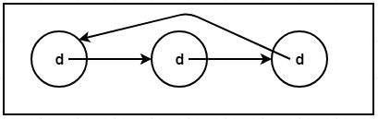
Ways to make an object eligible for garbage collection in Java-
4. Island of Isolation-Example
1. class Demo
2. {
3. Demo d;
4.
5. public static void main(string[ ] args)
6. {
7. Demo d1 = new Demo( );
8. Demo d2 = new Demo( );
9. Demo d3 = new Demo( );
10. .
11. .
12. d1.d = d2;
13. d2.d = d3;
14. d3.d = d1;
15. .
16. d1 = null;
17. d2 = null;
18. d3 = null;
19. }
20. }

